Slide 1
ASP.NET MVC CORE
Instructor: Edwin oduor

Slide 2

Quote of the day

Slide 3
Lesson objectives
Tag Helpers
Work with Boot Strap

Slide 4
Lesson pre-requisites
In order to take full advantage of this section you need to have the following;
Computer with Visual Studio Installed.
Stable Network Connection.

Slide 5
Training methods and extra readings
TRAINING METHODS FOR THIS LESSON
EXTRA READINGS
Lecturing Method – This is the main method of training to be adopted in this lesson with illustrations and practical coding examples.
Discussion Method - This method will be adopted periodically whereby learning will be derived principally from the students brainstorming together, rather than from the trainer. Three main types of discussions will be used:
Directed discussion
Developmental discussion
Problem-Solving discussion
Home and Learn C#

Slide 6
TAG HELPERS

Slide 7
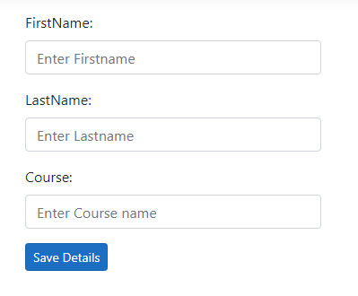
Tag helpers normally come in handy when the developer wants to get data from the user, for instance if one wants to capture registration details of users using the system then tag helpers can be used to achieve this. There are different built in tag helpers for instance we have tag helpers for generating links, creating forms etc., To use the tag helpers it has to be imported in the _View imports files.
To demonstrate this then will create another page, that is going to hold registration details of users using a form. Will be able to create a form like this.

Slide 8

To create a form shown in the previous slide. First will create a link, the link that will create will be using anchor Tag helper and here it is.
Let’s understand the above code that is using anchor tag helper, starting with the anchor tag and closing the anchor tag at the end. At the moment class part will ignore it for now but will revisit it, asp-controller referring to the controller that has the IActionResult in our case it is the home controller the next part is the IActionResult the name of the IActionResult, the last part is the text that will be displayed on the browser for the user to see and click on.
After the Link has been clicked on we want to go to that page that has the registration form. Therefore it means we are going to create a view so that the form can be displayed on the page when the link is clicked on. Before the view is created will create an IActionResult in the home controller then afterwards create the view.

Slide 9
Once the IActionResult has been created the next that will create is the view, right click on the IActionResult Register >> AddView >> Choose Razor view empty >> Add >> give it the name Register.
Will have an empty page from here now will start creating a form.
Start by using the basic HTML structure. Inside the body tag will create a form inside a div.
The entire code is in the next slide.

Slide 10
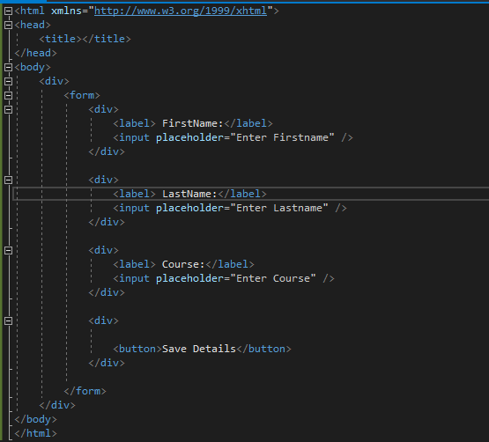
Here is the entire code showing how to use the form tag helpers.

Slide 11
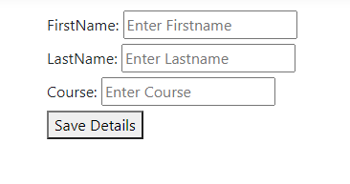
The output of the form created.
The output of the form does not look good or appealing on the eyes, to make it appealing will use bootstrap to achieve this.

Slide 12
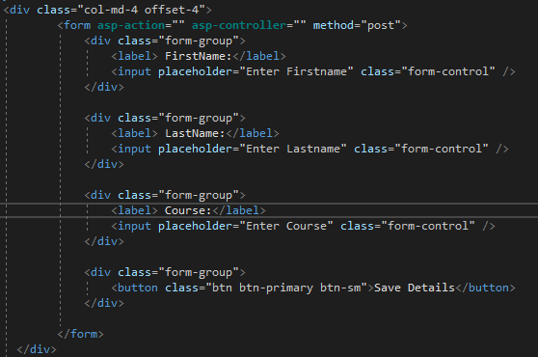
In the code below bootstrap has been introduced.

Slide 13
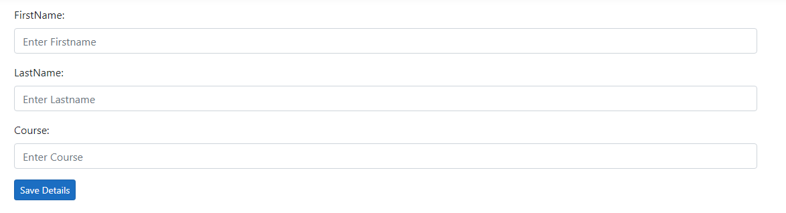
Here is the output of the previous code.
In the output above bootstrap has been introduced and as you can see the out put now looks great as compared to what we had in the previous output without boot strap.

Slide 14
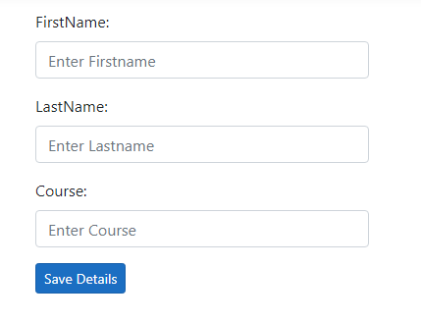
If the form is too long then, the width of the form can be reduced. By adding this code in the div that wraps the form.

